Slide 1


Amazon Reviews Analysis
Daily Data Analysis for a product listed on Amazon

Slide 2
Business Objective
Project P106
Need to get the daily analysis of a product of our choice, such as Emotions, Sentiments, etc.

Slide 3
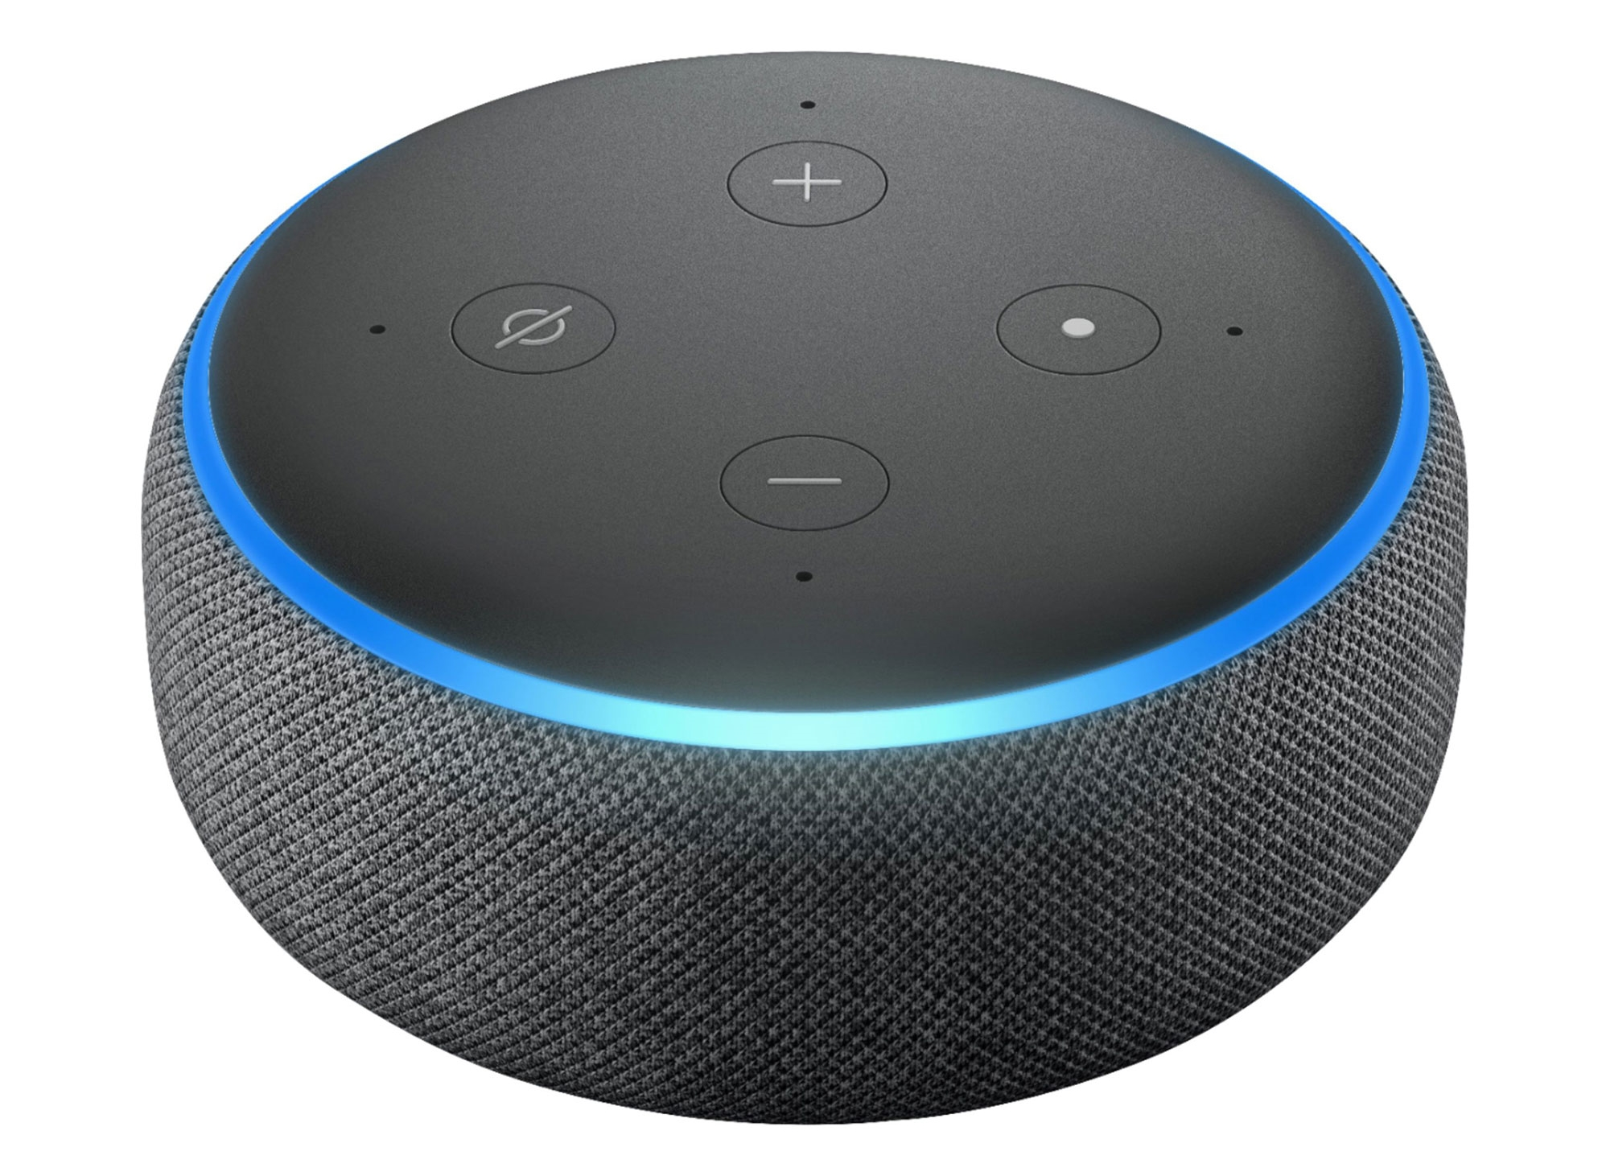
Echo Dot 3rd Gen
Group 4
S k Mohammad Akhleem Nawaz
Shaik Huda
Farhat Imam
Siddhesh Ranjan Manjrekar
Prathyush b r
Rupesh M

Slide 4
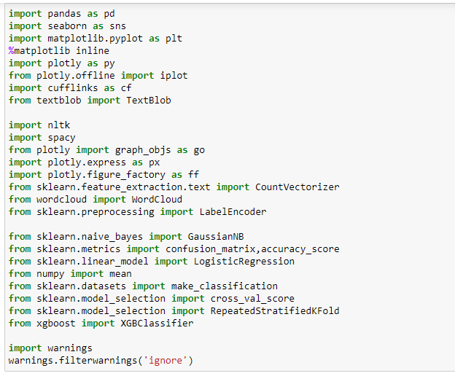
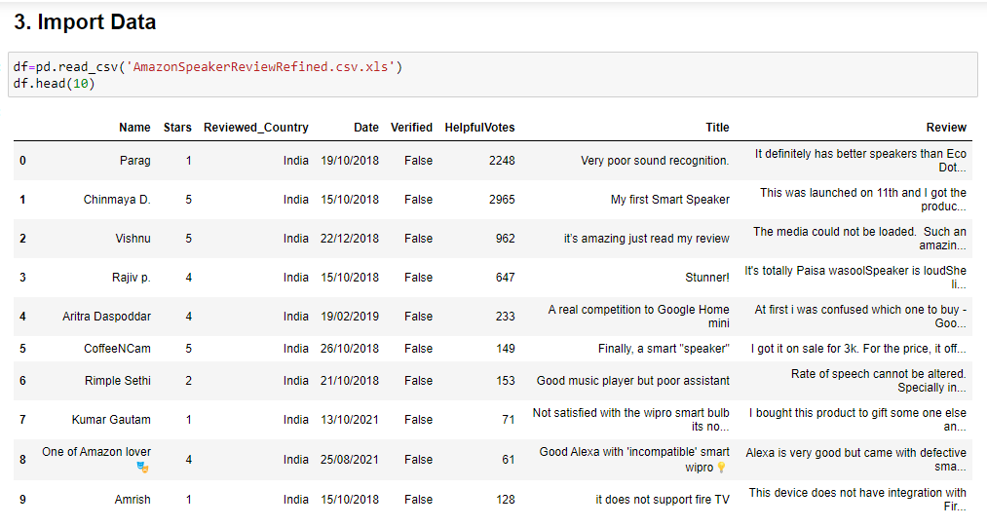
Libraries Used & Data

Slide 5
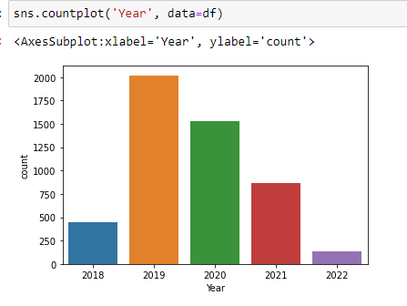
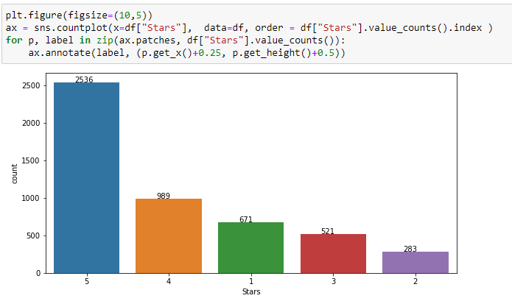
Exploratory Data Analysis
Data Preprocessing:
No null values
Checked for descriptive statistics
Data types
In 2019 and 2020 have got more reviews
2536 customers have given 5-star rating

Slide 6
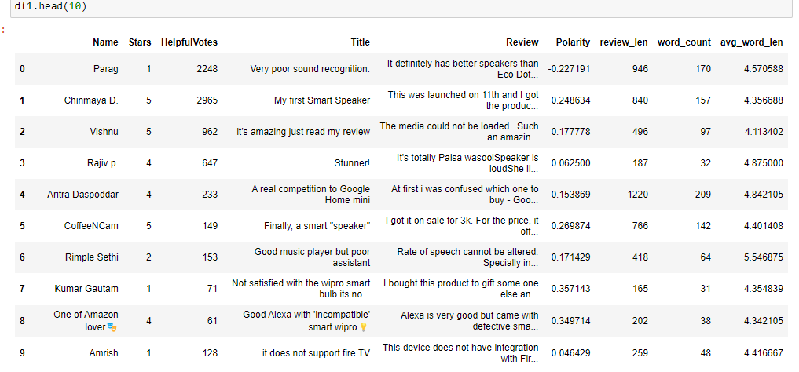
New features Polarity(says about how positive & negative a word is), Review length, word count, average word length

Slide 7
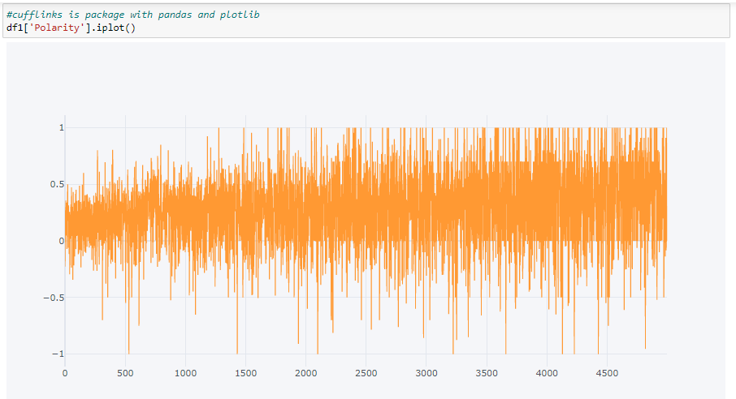
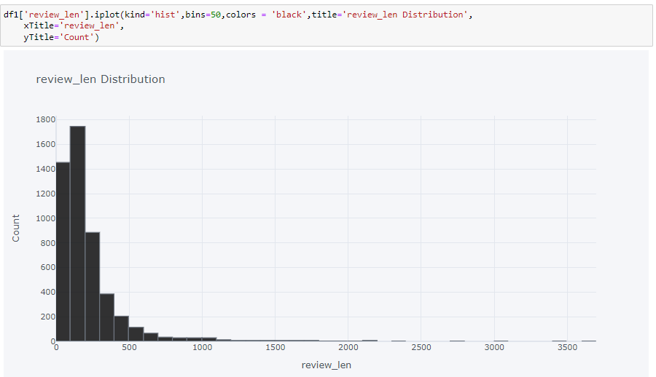
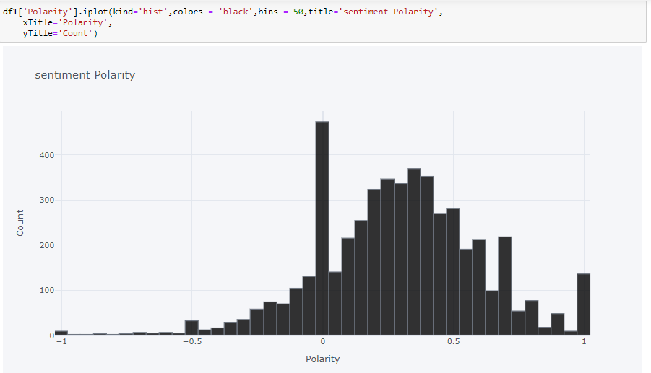
Visualizations of those Features with Plotly
Sentiment Polarity
Review Length

Slide 8
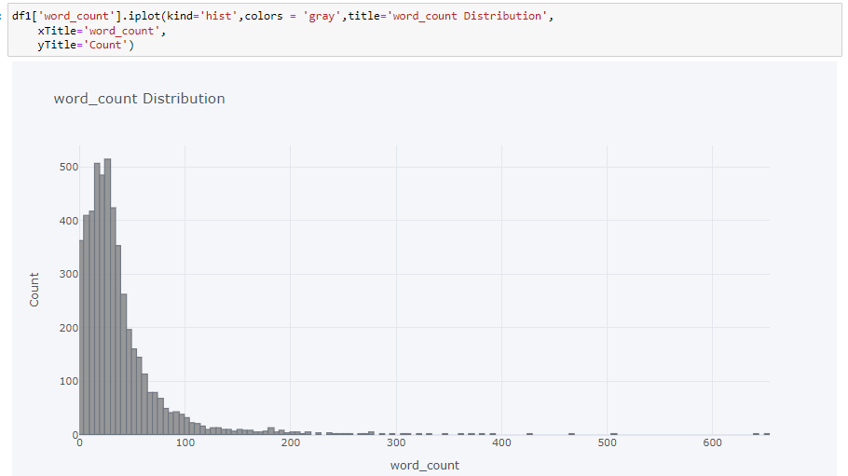
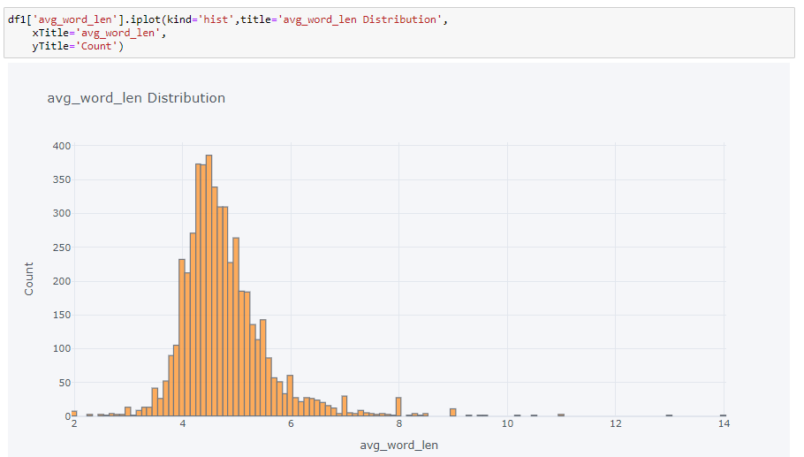
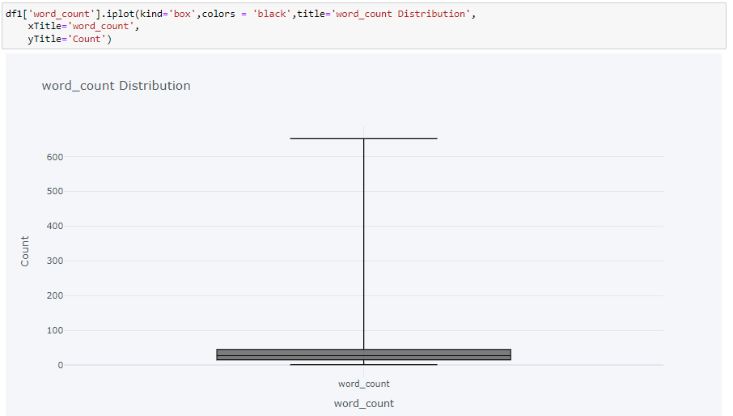
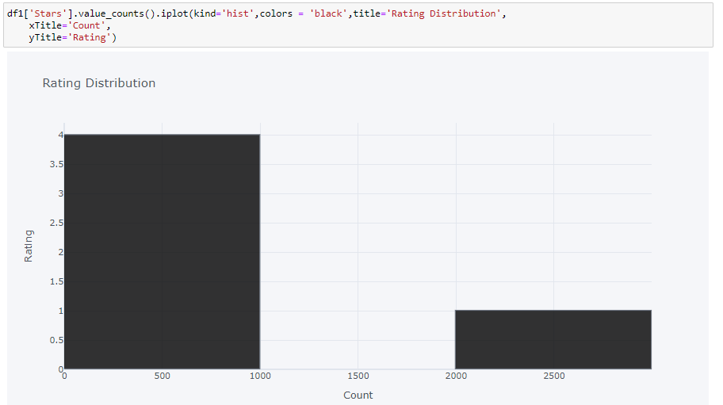
Average Word Length
Word Count with Histogram
Word Count with Box plot
Count of Rating

Slide 9
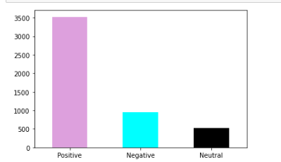
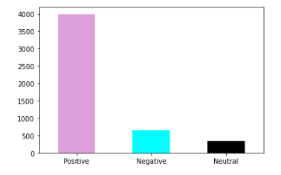
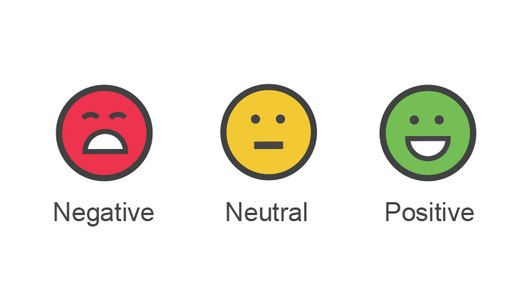
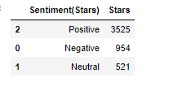
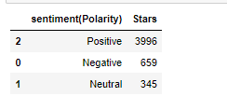
Sentiment Analysis It basically means to analyze and find the emotion or intent behind a piece of text or speech , especially in order to determine whether the writer's attitude towards a particular topic, product, is positive, negative, or neutral.
Sentiment Analysis with Polarity
Sentiment Analysis with Stars(Ratings)
Count
Count

Slide 10
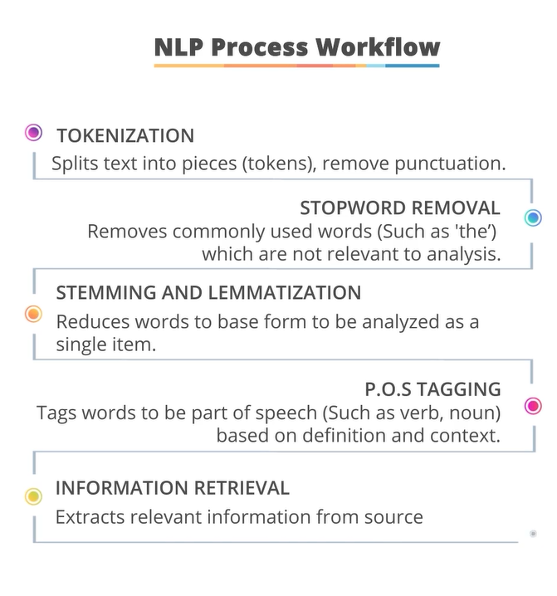
Text Cleaning And Preprocessing
Library used for Preprocessing the data
NLTK
NLTK (Natural Language Toolkit) Library is a suite that contains libraries and programs for statistical language processing. It is one of the most powerful NLP libraries which contains

Slide 11
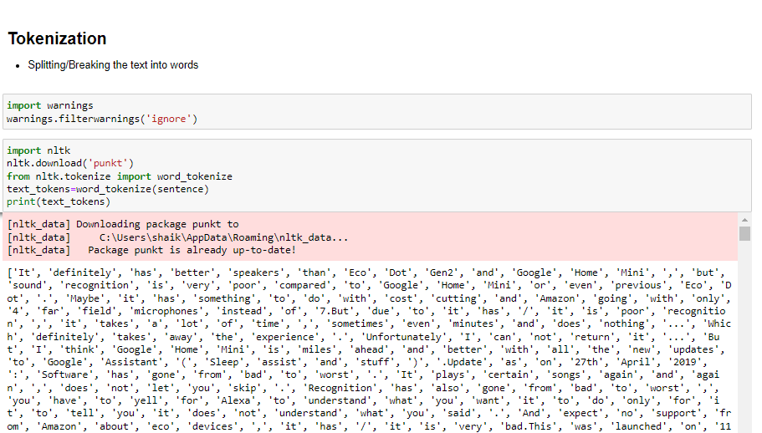
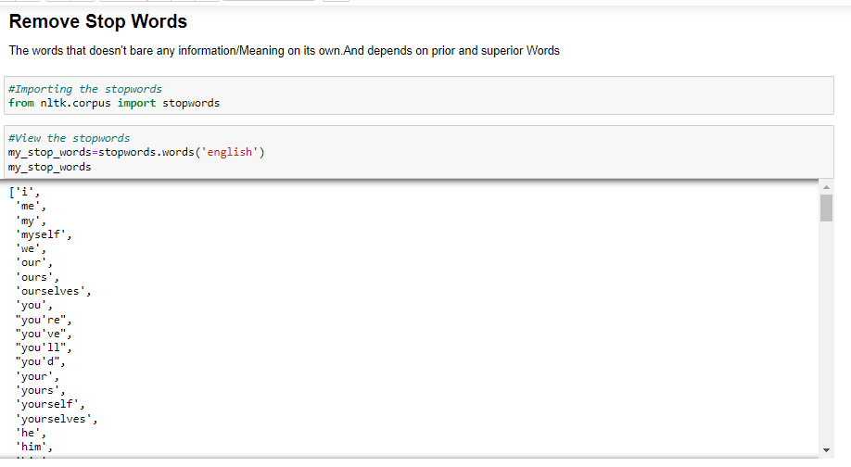
Tokenization
Remove Stop Words

Slide 12
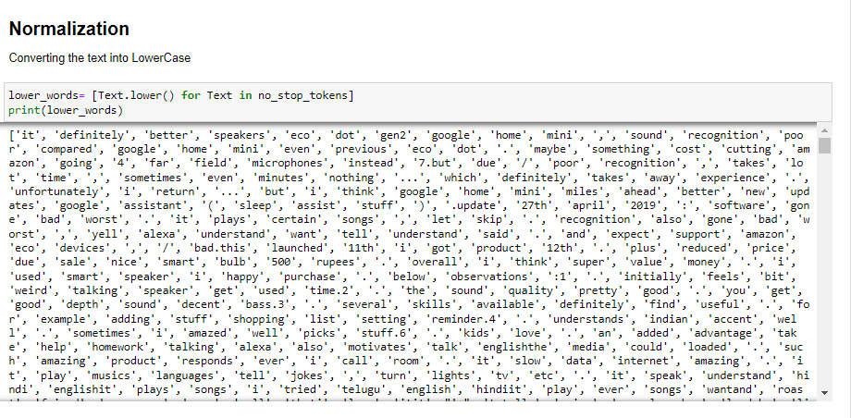
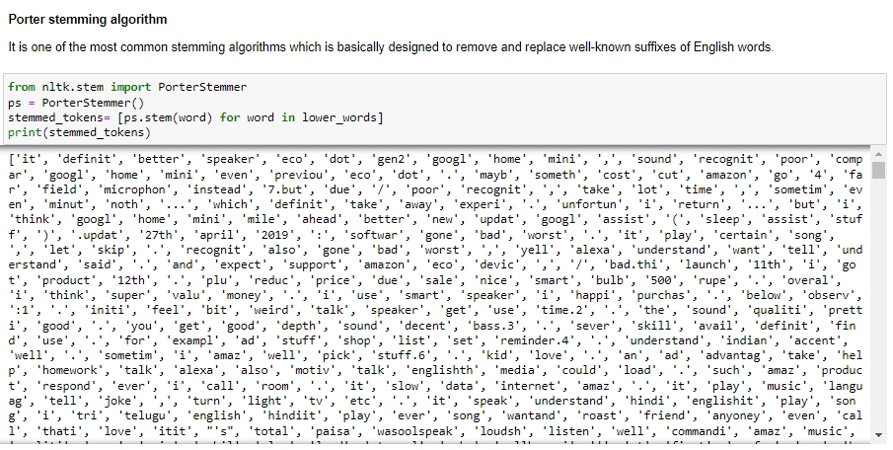
Normalization
Stemming

Slide 13
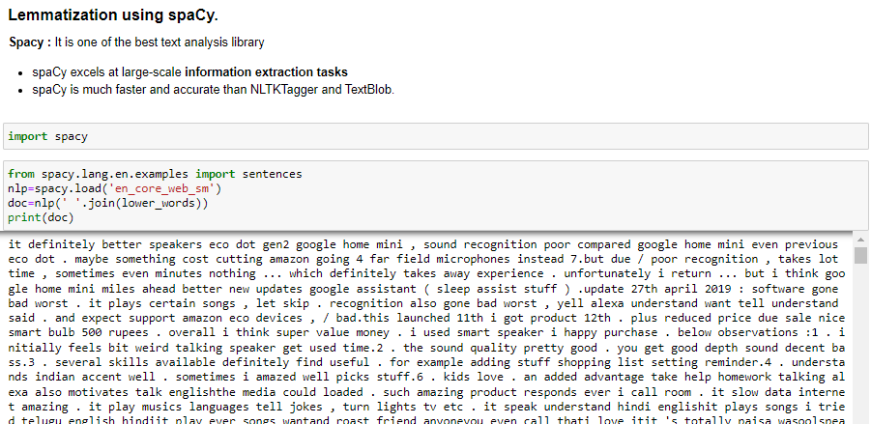
Lemmatization

Slide 14
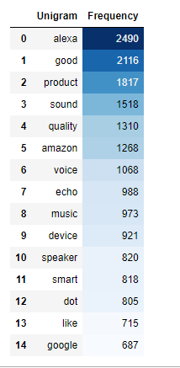
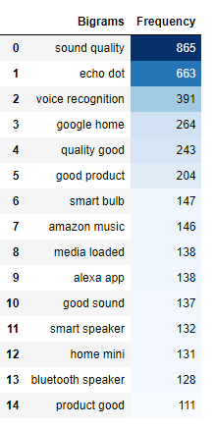
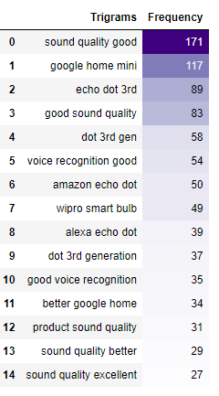
Feature Extraction Using Countvectorizer
Frequency /Count
Unigram
Bigram
Trigram
Distribution of Unigram, Bigram and Trigram
With two and Three Consecutive words in a sentence

Slide 15
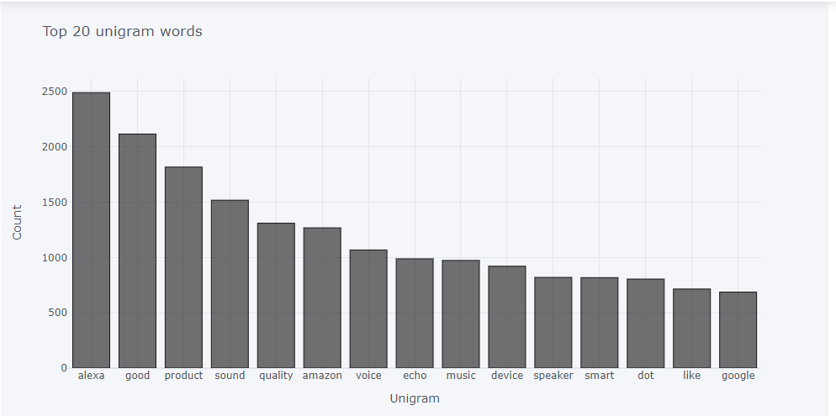
Count Of Unigram Visualizing through Histogram using Plotly

Slide 16
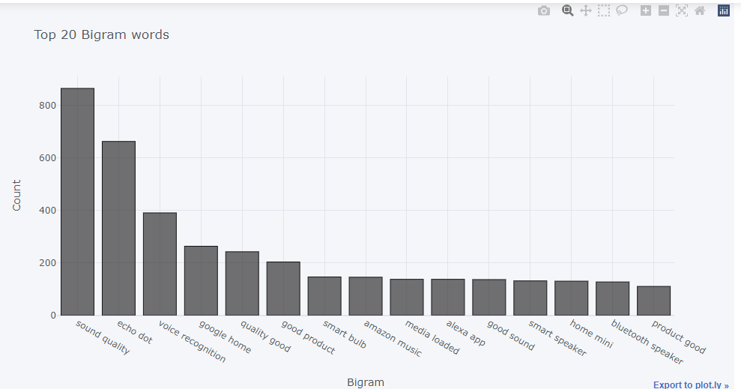
Count of Bigram visualizing through Histogram

Slide 17
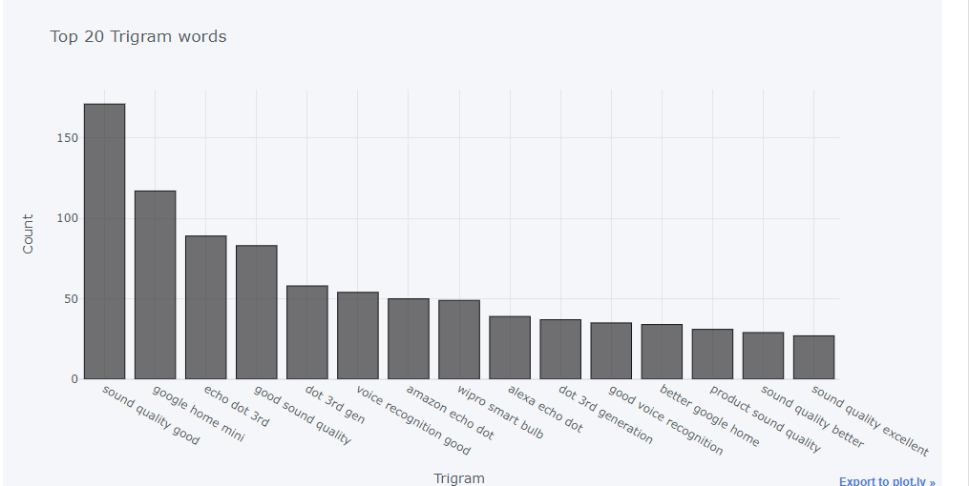
Count of Trigram visualizing through Histogram

Slide 18
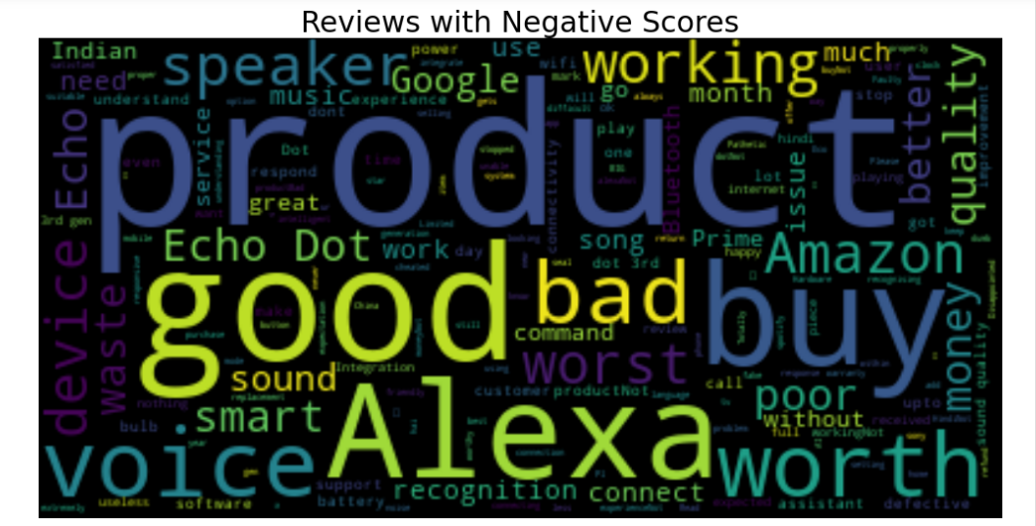
Word Cloud Generating Word cloud with Negative Reviews and Low product Rating

Slide 19
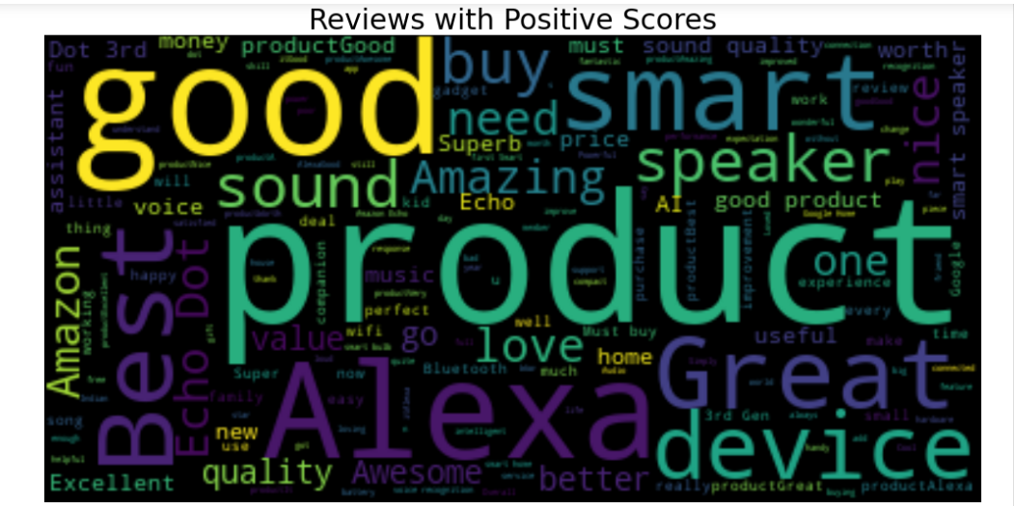
Word Cloud Generating Word Cloud with Positive Reviews And High product Rating

Slide 20
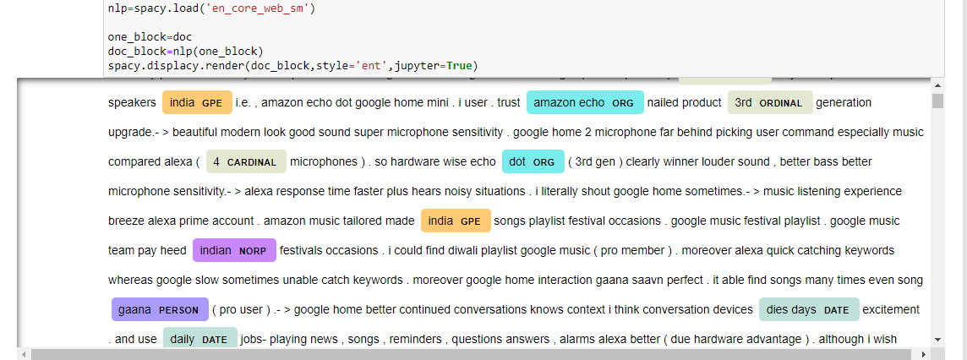
Named Entity Recognition
The key aim of performing Named Entity Recognition on a piece of text is to extract key information from the text, such as names of persons, Organization’s Locations, etc.

Slide 21
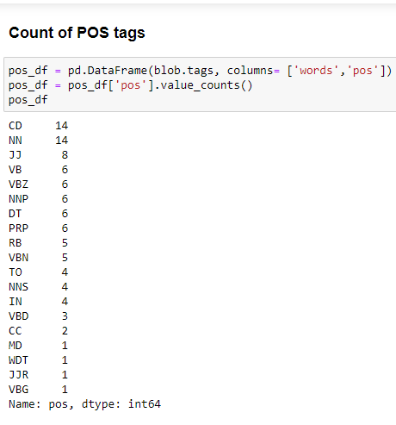
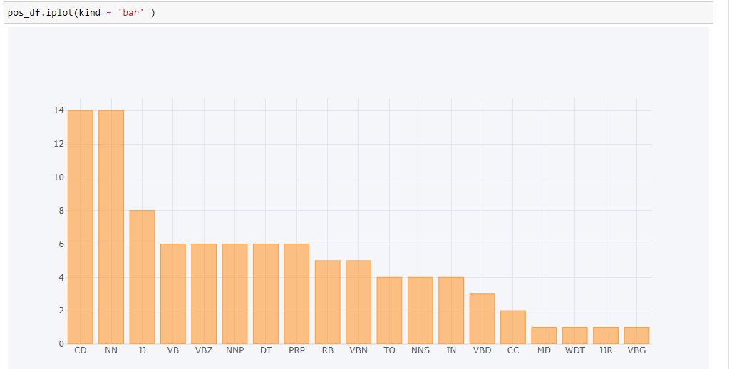
Count of POS Tags & Visualizing the count

Slide 22
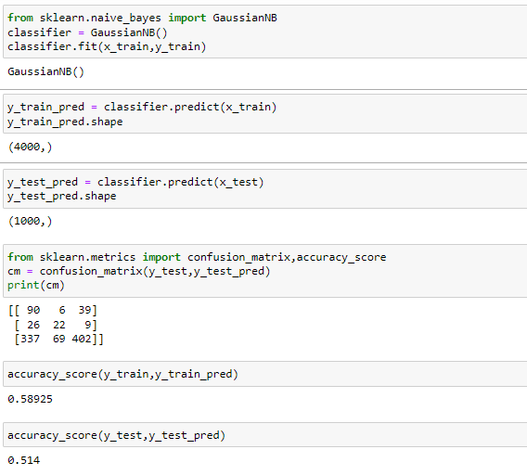
Model Building with Naïve Bayes
Inference:
Training Accuracy: 59%
Testing Accuracy: 51%

Slide 23
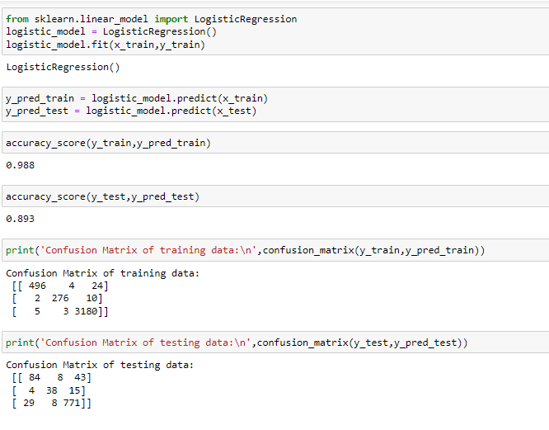
Model Building with Logistic Regression
Inference:
Training Accuracy: 98%
Testing Accuracy: 90%

Slide 24
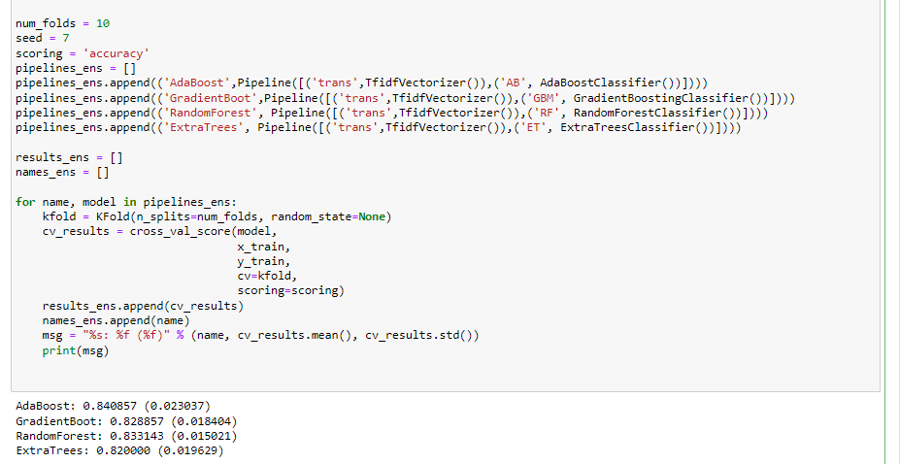
Evaluating Ensembles Algorithm

Slide 25
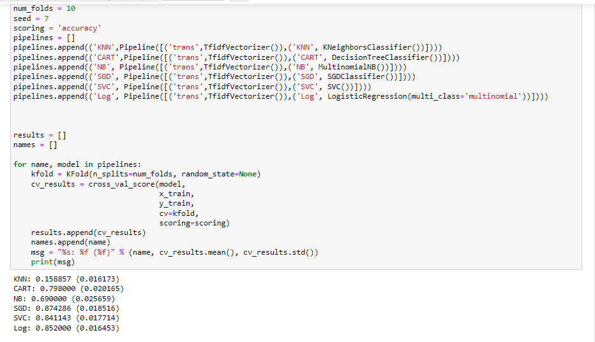
Evaluating Classification Algorithm
After balancing our dataset, we can see that the Classification algorithms like SGD, and SVC, perform better than the Ensemble algorithms used above.

Slide 26
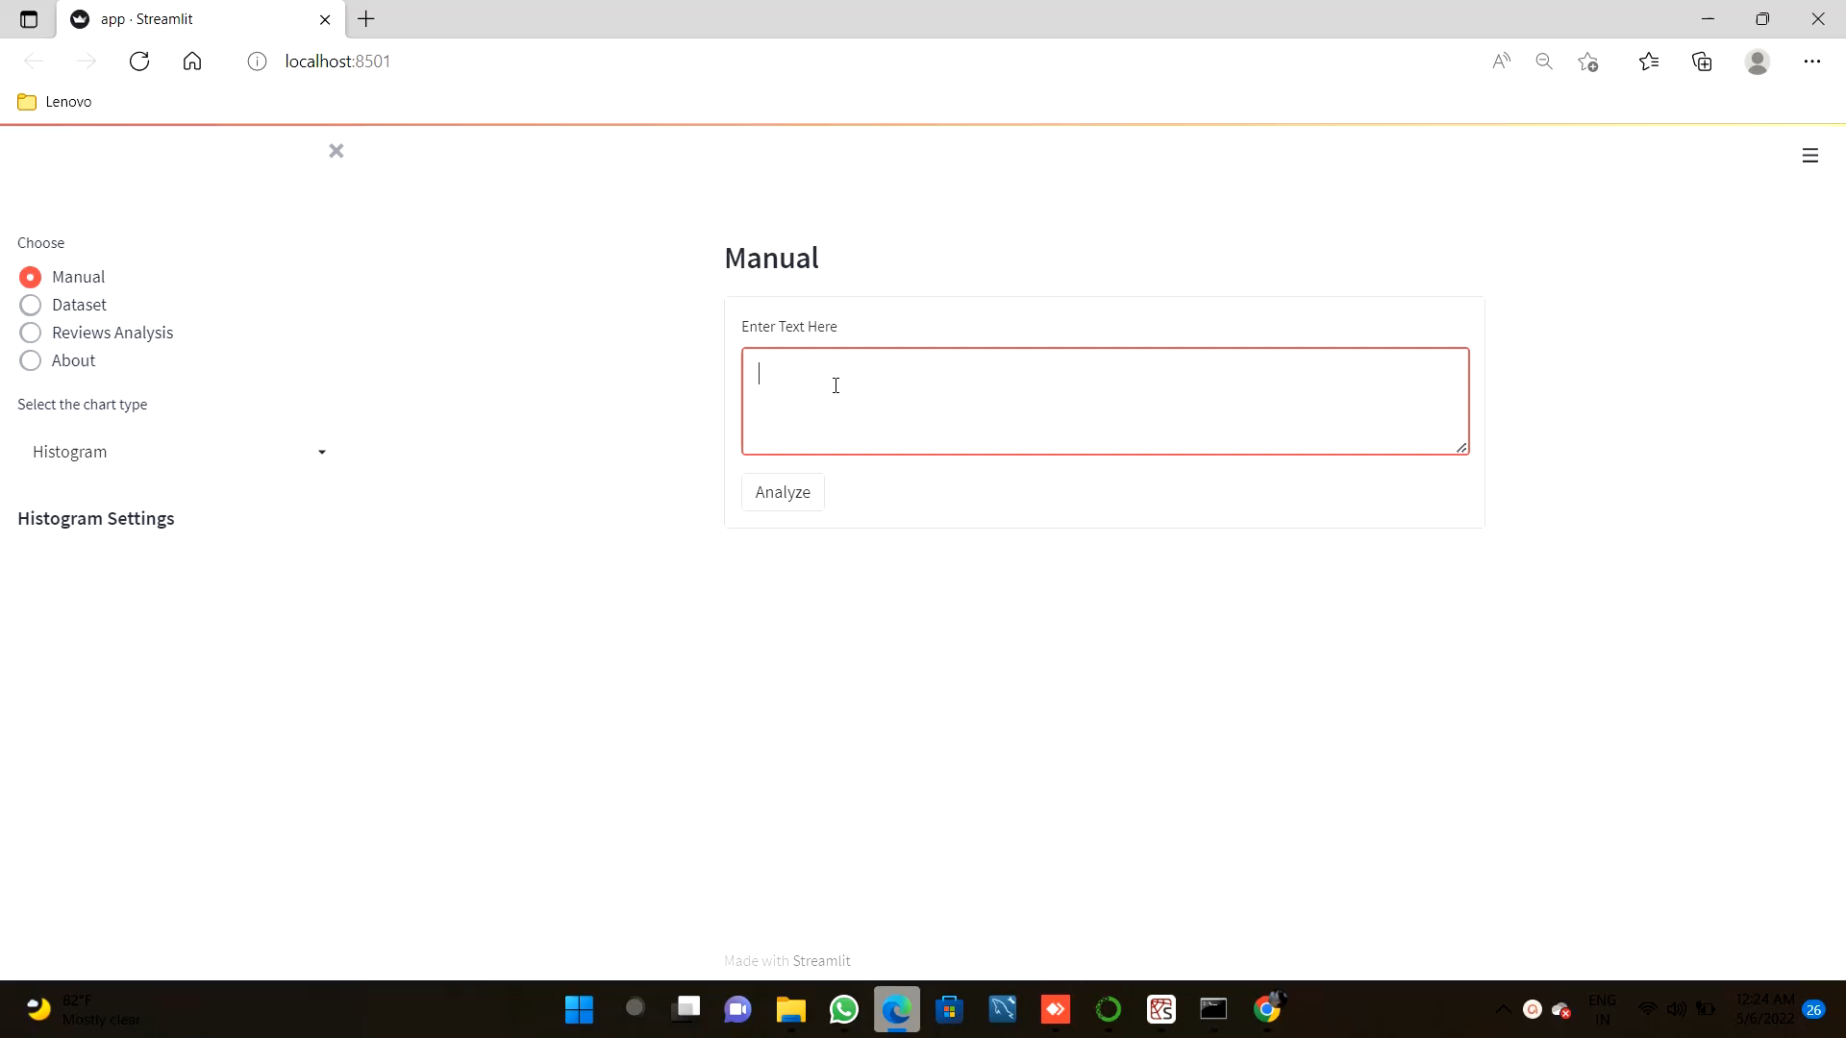
Model Deployment
In Manual tab we can see deployment by adding reviews Manually and see sentiment analysis
In Dataset and Review Analysis tab we can see Unigram, emoji analysis, ratings & polarity Analysis as per selected ratings and graphs respectively by adding .csv file or .xlsx file

Slide 27
Thank You

